Slide 1
Civilian Methamphetamine Awareness Training

Slide 2
History of Meth
1887 AMPHETAMINE FIRST SYNTHESIZED
1919 METHAMPHETAMINE FIRST SYNTHESIZED
1932 SOLD AS NASAL SPRAY IN U.S.
1930‑40'S FIRST EPIDEMIC USE
- USED BY ALLIED AND AXIS TROOPS
1960'S SECOND EPIDEMIC
1970'S METH PRODUCTION REGULATED
LATE 1980'S SMOKEABLE METH FROM JAPAN/KOREA SPREADS TO U.S.
1990'S METH SPREADS FROM CALIFORNIA EASTWARD
Notes:
Amphetamine was synthesized in Germany
Methamphetamine synthesized by Japan
Used to keep troops awake (30’s and 40’s) High doses given to Japanese Kamikaze pilots
90’s Mexican drug trafficking organizations set up large labs
Ultimately spreads from the US to Europe and the Czech Republic

Slide 3
Illinois Meth Labs
1996 1st Seizure
Adams County
1997-24 | 2002-668 | 2007-446 | 2012-785
1998-87 | 2003-971 | 2008-390 | 2013-753
1999-246 | 2004-962 | 2009-448 | 2014-760
2000-403 | 2005-973 | 2010-457 | 2015-723
2001-666 | 2006-786 | 2011-573 | 2016-559
 |  |  | 2017-238
 |  |  | 2018-137 2019 - 62

Slide 4
Formation of Illinois State Police Meth Response Teams (MRT)
February 2005: Illinois State Police announce the formation of 6 dedicated MRT’s.

Slide 5
Meth Response Teams
Formation of Meth Teams allow:
Increased response coverage throughout the state
Alleviates Metropolitan Enforcement Group (MEG) and drug task forces
Increased number of meth labs seized and meth related arrests

Slide 6
Predominant Lab Types
Birch Reduction Method (Anhydrous Ammonia)
Red Phosphorus Method (Red P)
One-Pot Method (Shake-n-Bake)
Notes:
Dangers across all three types : Chemical exposure / splashes and spills involving acids and bases; chemical gas exposure (lung eyes / nose / mouth “mucous membranes”; fire from exothermic reactions or introduction of flame to flammable substance (usually a solvent) / Lithium metal volatility

Slide 7
PSE to Meth
Addition of Lithium Metal and Ammonia Gas to PSE
Removes Oxygen atom from molecular structure
Result = Methamphetamine
Notes:
PSE is an isomer of ephedrine – have the same compound with same formula but with a different arrangement of atoms in the molecule and different properties.

Slide 8
Birch Reduction Method / Anhydrous Lab

Slide 9
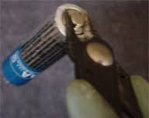
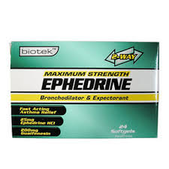
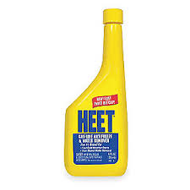
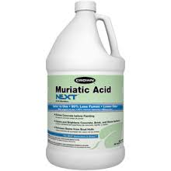
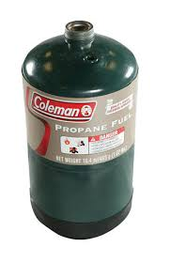
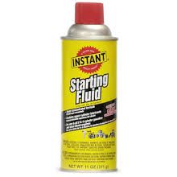
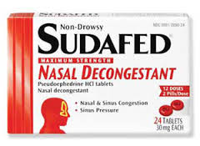
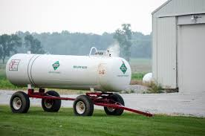
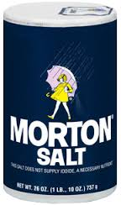
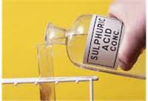
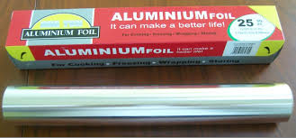
Anhydrous Lab Ingredients:
Ephedrine/Pseudoephedrine
Anhydrous Ammonia
Lye – Sodium Hydroxide
Lithium strips (batteries)
Ether (starting Fluid)
Methanol (Heet)
Camp Fuel
Toluene
Acetone
Sulfuric Acid
Muriatic Acid
Salt
Aluminum Foil

Slide 10
Key Holed cans

Slide 11
Anhydrous Meth Hazards
CONTAINERS USED TO TRANSPORT ANHYDROUS AMMONIA
Propane tanks
Coolers
Thermos
Gas can
Mason jars
Fire extinguisher
Air compressor tanks

Slide 13
Anhydrous Meth Hazards
DO NOT OPEN ANY CONTAINER THAT YOU SUSPECT TO CONTAIN ANHYDROUS AMMONIA!!!!!!!!

Slide 14
Anhydrous Meth Hazards
ANHYDROUS AMMONIA INJURIES
Frostbite
Burns
Blindness
Respiratory
Death

Slide 15
Red Phosphorus Method Red P Lab

Slide 16
Red P Lab Ingredients
Ephedrine/Pseudoephedrine
Red Phosphorus (match books)
Iodine
Lye – Sodium Hydroxide
Hydrogen peroxide
Ether (starting fluid)
Methanol (Heet)
Camp Fuel
Toluene
Acetone
Sulfuric Acid
Muriatic Acid
Salt
Aluminum Foil

Slide 17
Red P Hazards
PHOSPHINE GAS
Given off during reaction stage
Odorless
Colorless
Tasteless
IT WILL KILL YOU!!!!

Slide 18
One Pot Method Shake-n-Bake Lab

Slide 19
One Pot Ingredients
Ammonium Nitrate
Lithium strips
Lye
Ether or Coleman Fuel
Ephedrine/Pseudoephedrine
Water

Slide 20
One Pot Preparation
Combine ammonium nitrate, crushed pills, ether, lithium strips, and water in a soda/water bottle
Reaction will begin
Must continue to vent and add lye to mixture
Meth is salted out using the same methods as Anhydrous and Red-P

Slide 21
One Pot Demonstration

Slide 22
One Pot – Tulsa, OK PD

Slide 23
Lithium Metal with H₂O

Slide 24
Meth Manufacturing Waste

Slide 25
Clandestine Laboratory Indicators
APPARATUS
Blenders/Grinders
Glassware (mason jars or Tupperware)
Coffee filters
Tubing
Aquarium pump
Gas Generators
Wooden spoons
Funnels
Hotplates
Rubber gloves
Fire Extinguishers
Propane Tanks

Slide 26
Common Indicators
WASTE
Coffee Filters
Dry/Wet powders emitting chemical odors
Key holed starting fluid cans
Empty pseudoephedrine boxes and blister packs
Rubber gloves
Lithium battery remnants/packaging

Slide 27
Other Lab Indicators
Windows open on cold days
Unusual ventilation practices
Odors emanating from residence
Windows covered or blocked
People going outside to smoke
Video surveillance cameras outside the residence

Slide 28
Awareness Level Responsibilities
Identify
Evacuate
Protect yourself and others (DO NOT TOUCH ANYTHING)
Call for proper assistance

Slide 29
Meth Lab Investigations
Most labs discovered by:
Investigative leads
Crime stoppers tips
Traffic stops
Domestic disputes
Probation personnel
Fires
Medical emergencies
Pseudoephedrine sales log violations

Slide 30
Meth lab Investigations
A meth lab certified officer is needed if you have:
Solutions/layered solutions
Gas generator(s)
Anhydrous containers
Lithium strips
ANY INGREDIENT/APPARATUS YOU ARE UNSURE OF
DON’T TRUST LABELS
Anything you think could be a clandestine lab production

Slide 31
The Effects of Meth

Slide 32
Short Term Effects
Euphoria
Hyper excitability
Extreme nervousness
Elevated pulse, blood pressure, body temperature
Sweating
Restlessness
Insomnia
Teeth grinding
Incessant talking
Hallucinations
Paranoia
Violence

Slide 33
Meth Abuse Indicators
Weight loss
Sweating
Body odor
Dental problems
Hair loss
Extreme or unnatural paleness
Scabs/sores “METH BUGS”

Slide 35
BEFORE DRUGS
AFTER DRUGS
1998
2002

Slide 36
Dealing with Users
Maintain a social distance.
Lights-Don’t shine in their eyes
Try to speak slowly
Try to slow your movements
Keep your hands visible
Keep them talking

Slide 37
Methamphetamine Precursor Control Act (MPCA)
Took effect January 15, 2006
What is a precursor?
Anything containing the ingredient Ephedrine or Pseudoephedrine

Slide 38
MPCA continued
What is required to purchase Pseudoephedrine:
* Present a driver’s license or other government ID
* Customer must sign a pseudoephedrine sales log

Slide 39
Meth Awareness Training
Practical Exercises

Slide 40
Exercise Goals:
Be able to visually identify materials commonly used in the clandestine manufacture of methamphetamine.
Be able to articulate what safety hazards exist based upon your observations and experience.
Enhance safety upon discovery of a clandestine drug laboratory or manufacturing materials.
Disseminate protocol for ISP MRT notification.

Slide 41
Pay Attention to Your Senses
Sight
Feel
Smell
Sound

Slide 42
Material Identification
Let’s identify the following items commonly found in the clandestine manufacture of methamphetamine:

Slide 43
PSEUDOEPHEDRINE HYDROCHLORIDE (PRECURSOR)

Slide 44
SODIUM HYDROXIDE – LYE / CAUSTIC SODA

Slide 45
PLASTIC TUBING

Slide 46
COFFEE FILTERS

Slide 47
AMMONIUM NITRATE

Slide 48
LITHIUM METAL

Slide 49
PLIERS / WIRE CUTTERS

Slide 50
METHANOL

Slide 51
LIGHT HYDROTREATED DISTILLATE (FUEL SOLVENT)

Slide 52
HYDROGEN PEROXIDE

Slide 53
RUBBER GLOVES

Slide 54
COMMON CONFIGURATIONS OF HYDROGEN CHLORIDE (HCL) ACID GAS GENERATORS

Slide 55
SULFURIC ACID

Slide 56
SODIUM CHLORIDE (SALT)

Slide 57
OR

Slide 58
MURIATIC ACID

Slide 59
ALUMINUM FOIL

Slide 60
LET’S PRACTICE!
What do you observe in the following slides?
What can you articulate based upon your training and experience?
Are there health and safety hazards to consider?
What would you do?

Slide 61
First, an easy one…

Slide 62
But what about this?

Slide 63
Or this?

Slide 64
Consider these two items…

Slide 65
Or these three innocuous items

Slide 66
What if you see this? Are there any hazards?

Slide 67
What about these three?

Slide 68
You recognize these two…

Slide 69
But what about these two?

Slide 70
Another easy one…

Slide 71
Safety Concerns?

Slide 72
How about now?

Slide 73
Or now?

Slide 74
How many of you have seen this?

Slide 75
Reporting a suspected clandestine methamphetamine laboratory
Contact Illinois State Police District Headquarters in your area
Zone 4 / Peoria MRT (Fulton, Knox, Marshall, Peoria, Stark, Tazewell, Woodford) (during business hours)
TX: (309) 693-5015

